Slide 1
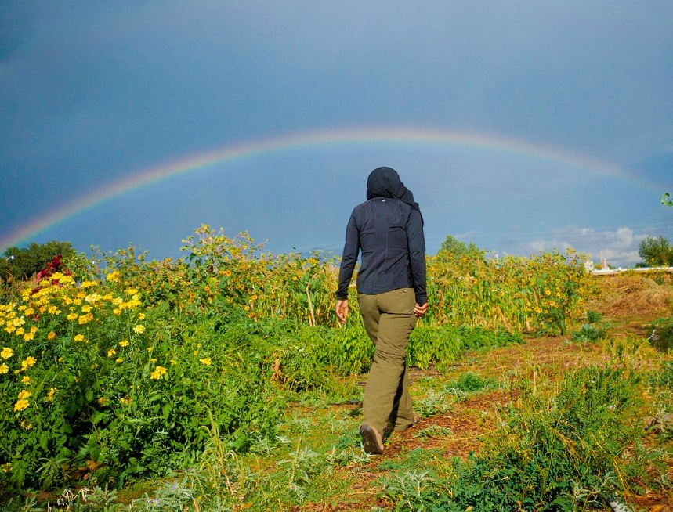
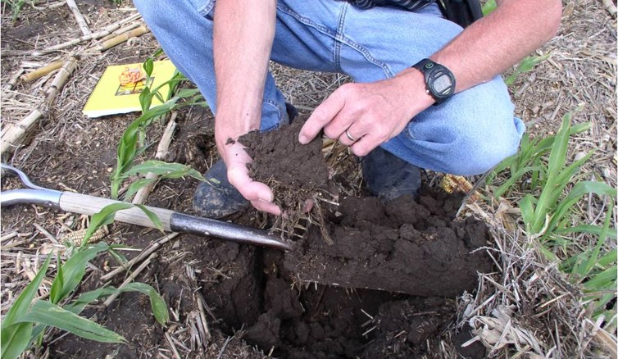
Improving Water Quality One Field at a Time: NRCS Practices for Producers

Slide 2
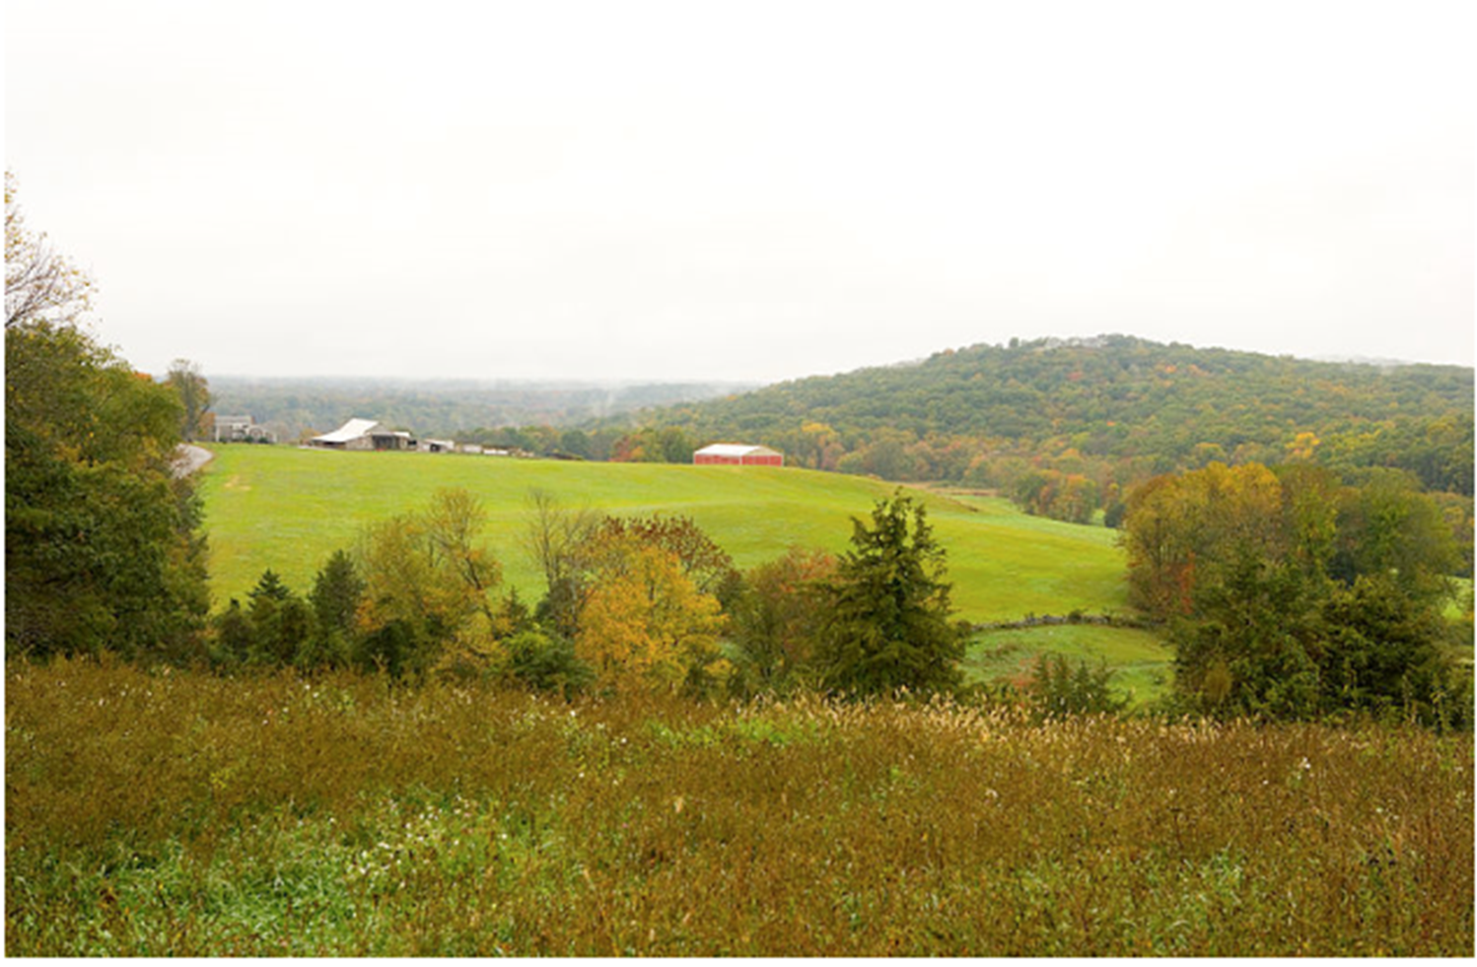
The Natural Resources Conservation Service (NRCS) is a federal agency within the U.S. Department of Agriculture that works with private landowners and operators, through voluntary conservation, to promote productive and sustainable lands.

Slide 3
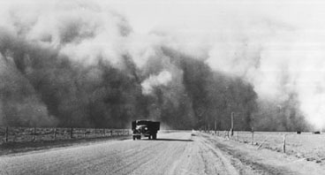
Origin of NRCS
The Soil Conservation Service (SCS) was created during the Dust Bowl in the 1930s to control soil erosion on farms.
In 1994, SCS became the Natural Resources Conservation Service (NRCS) & now in addition to soil as a resource, also addresses; water, air, plants, animals, and energy on farms.

Slide 4
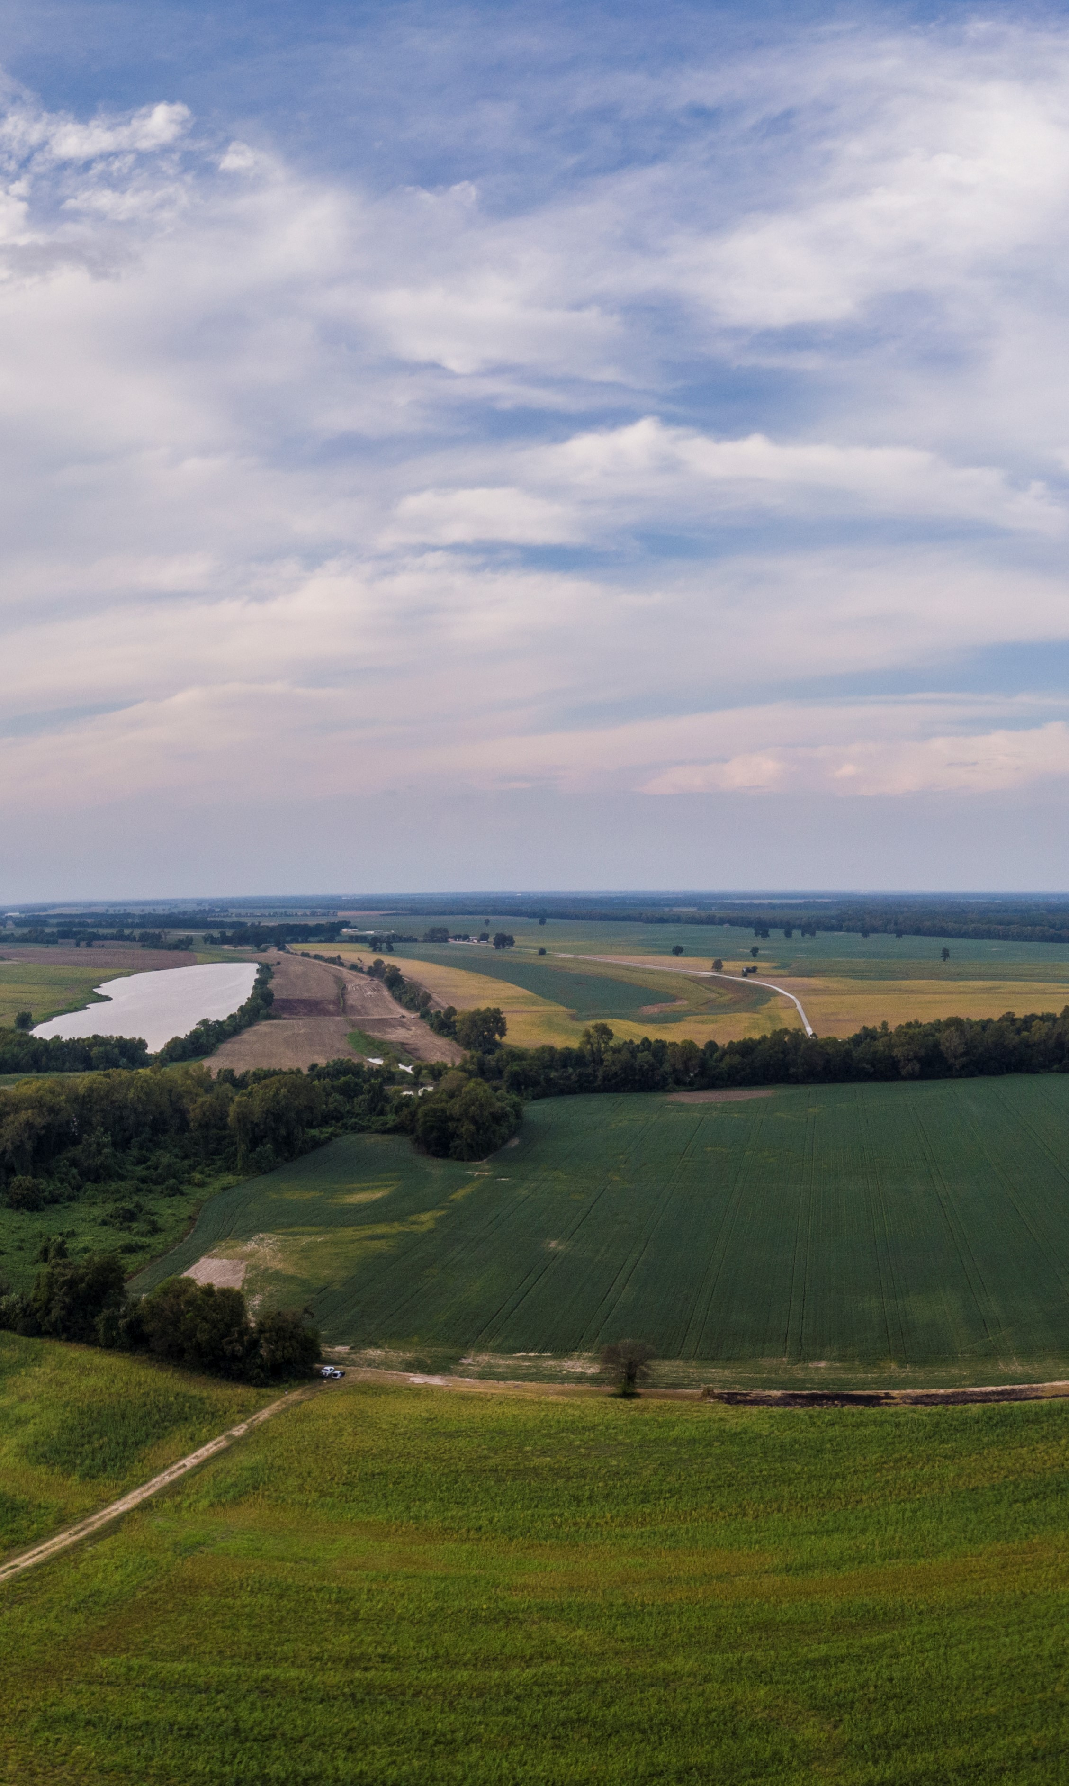
NRCS Practices and Water Quality
Agricultural producers can play a critical role in reducing erosion, nutrient movement and sedimentation, and deliver lasting solutions to Water Quality Resource Concerns
Implementation of conservation practices can also help farmers adapt to weather extremes and can help mitigate effects of climate change.

Slide 5
NRCS helps farmers improve soil health, water (quality & quantity), air quality, plant health, animals (livestock & wildlife habitat), and energy conservation through;
Technical Assistance - available to assist landowners [or operators] who want to make conservation improvements on their land.
Financial Assistance - available to eligible producers through program contracts, who want financial support to implement recommended conservation practices.

Slide 6
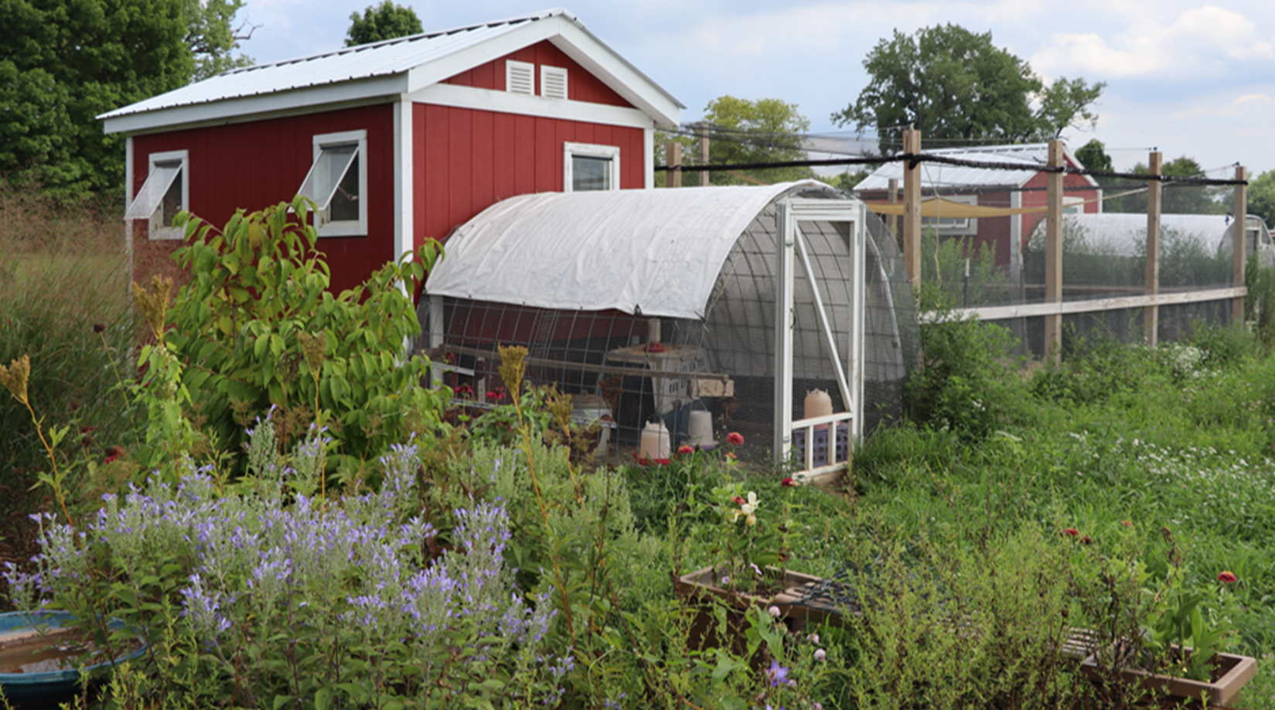
NRCS supports farmers, ranchers, and private forest landowners in meeting their conservation goals, regardless of the size, location, and type of operation. We can assist with traditional farming operations, as well as urban farms and forest lands

Slide 7
NRCS Water Quality Resource Concerns
Nutrients transported to surface and ground water
Pesticides transported to surface and groundwater
Pathogens and chemicals from manure, bio-solids or compost applications transported to surface and groundwater
Salts transported to surface and groundwater
Petroleum, heavy metals and other pollutants transported to surface and groundwater
Sediment transported to surface water

Slide 8
NRCS Soil Resource Concerns (selected)
Sheet and Rill Erosion
Wind Erosion
Ephemeral Gully Erosion
Classic Gully Erosion
Bank Erosion from streams, shorelines or water conveyance channels
Soil organism habitat loss or degredation

Slide 9
Erosion – A Soil and Water Quality Issue
Sheet and Rill Erosion and Ephemeral Gully Erosion on a corn field in spring

Slide 10
Erosion – a Soil and Water Quality Issue
Classic Gully erosion from a hay field, and why bandaids may not work.

Slide 11
Water Quality – input impacts
Spreading farm inputs – whether manure, compost, pesticides or lime – can provide a pathway water quality impacts

Slide 12
Water Quality – animal damage
Pasturing animals in wet soils or during the wrong season can cause sedimentation and water quality issues.

Slide 13
Forest Erosion
Forestry can bring water quality issues. A poorly placed forest trail can erode.

Slide 14
So how does NRCS help landowners with these resource concerns?

Slide 15
It starts with a Conservation Plan with practices chosen to fix the resource concerns.

Slide 16
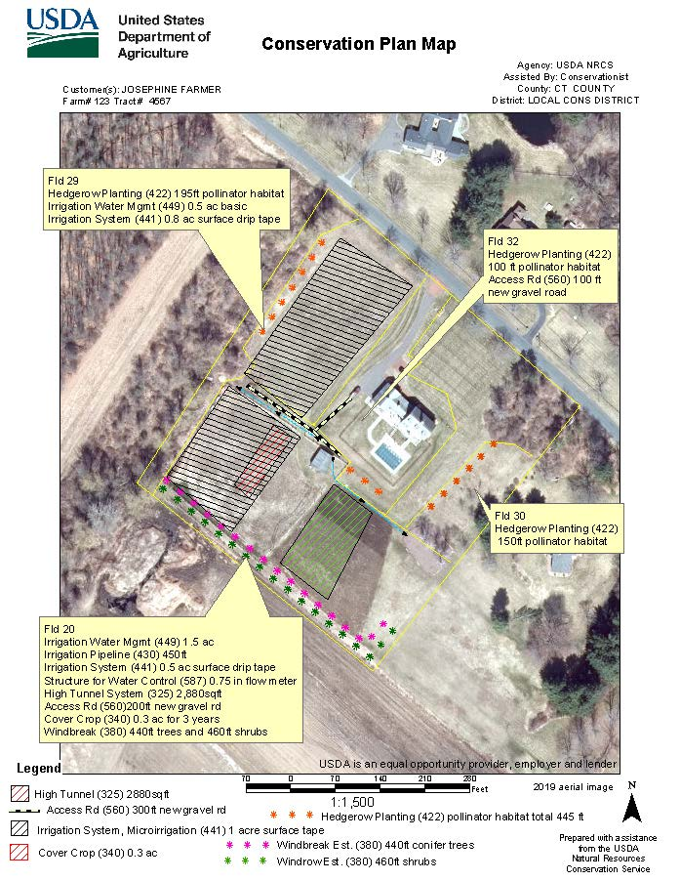

Slide 17
Planning Practices Payments to producers to pay for the development of a Resource Management Plan, Implementation requirement or Testing.
Nutrient Management Plan
Comprehensive Nutrient Management Plan
Grazing Management Plan
Soil Health Management Plan
Forest Management Plan
Soil and Source Testing for Nutrient Management
Site Assessment and Soil Testing for Contaminant Activity

Slide 18
Implementation Practices Payments to producers for the Installation of a Practice

Slide 19
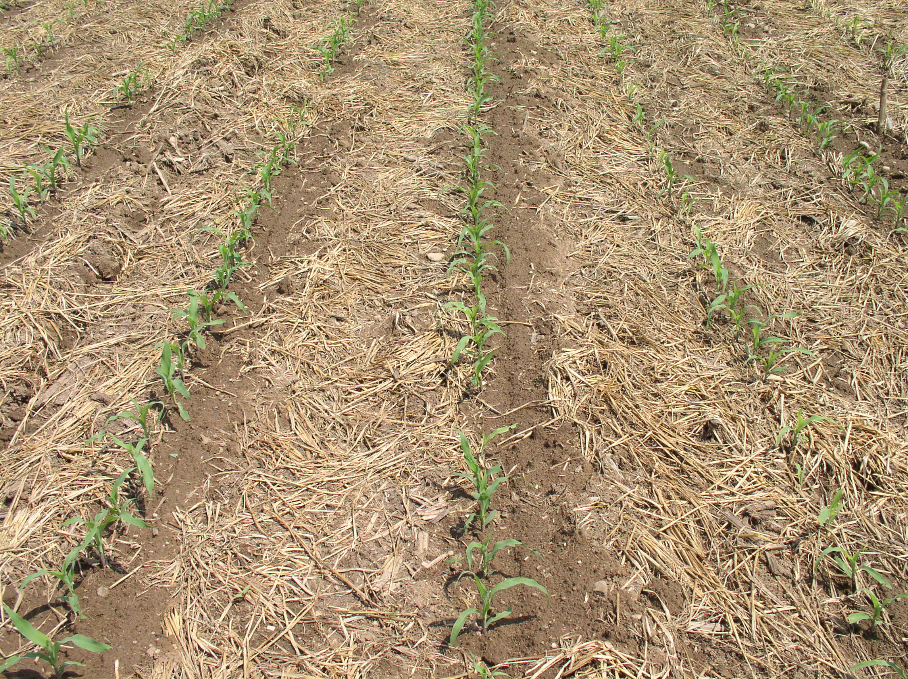
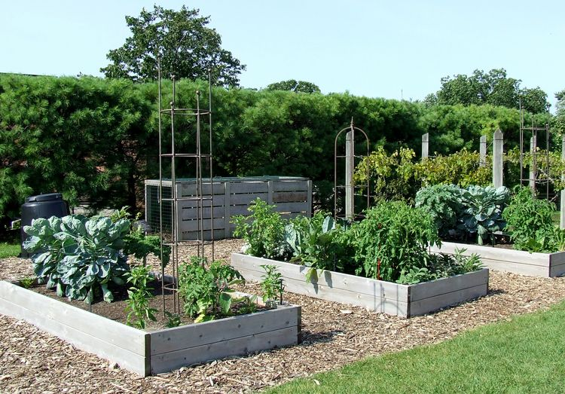
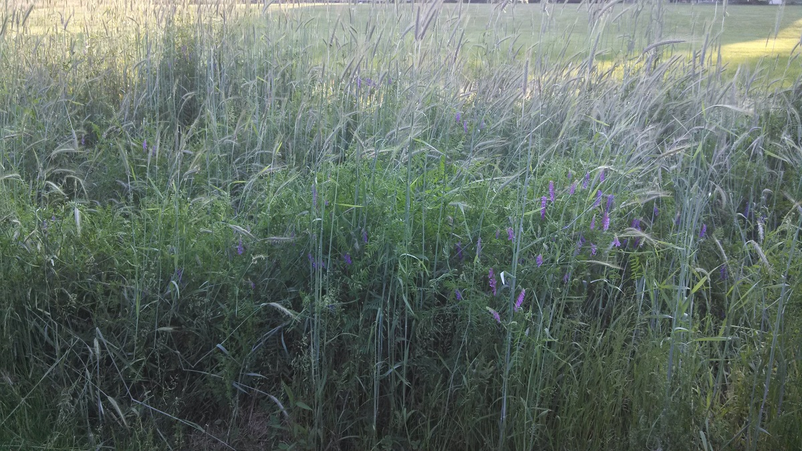
Erosion Control Practice Examples
No-Till
Cover Crop (multi- species )
Raised Beds and Mulch

Slide 20
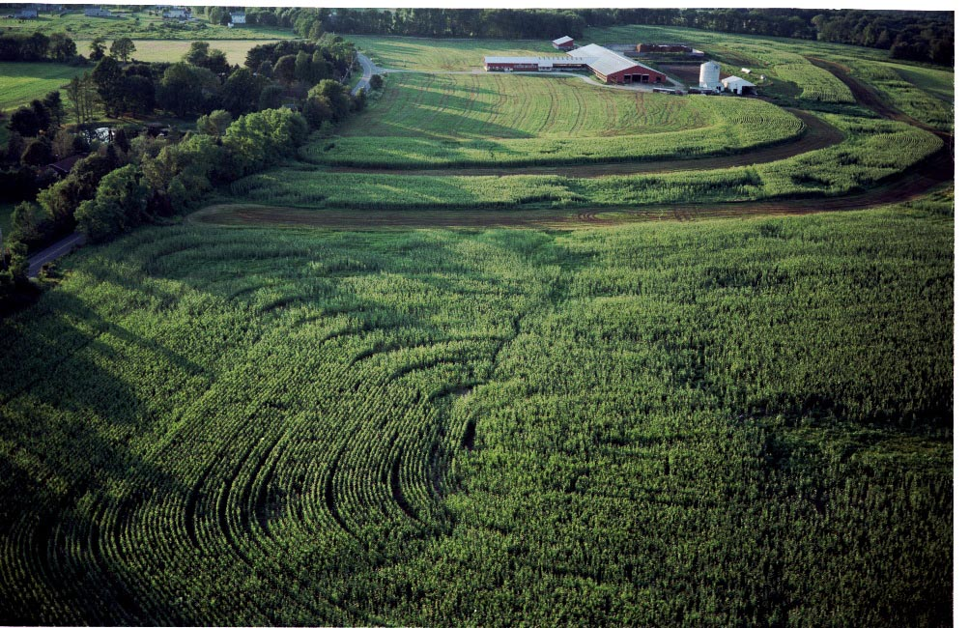
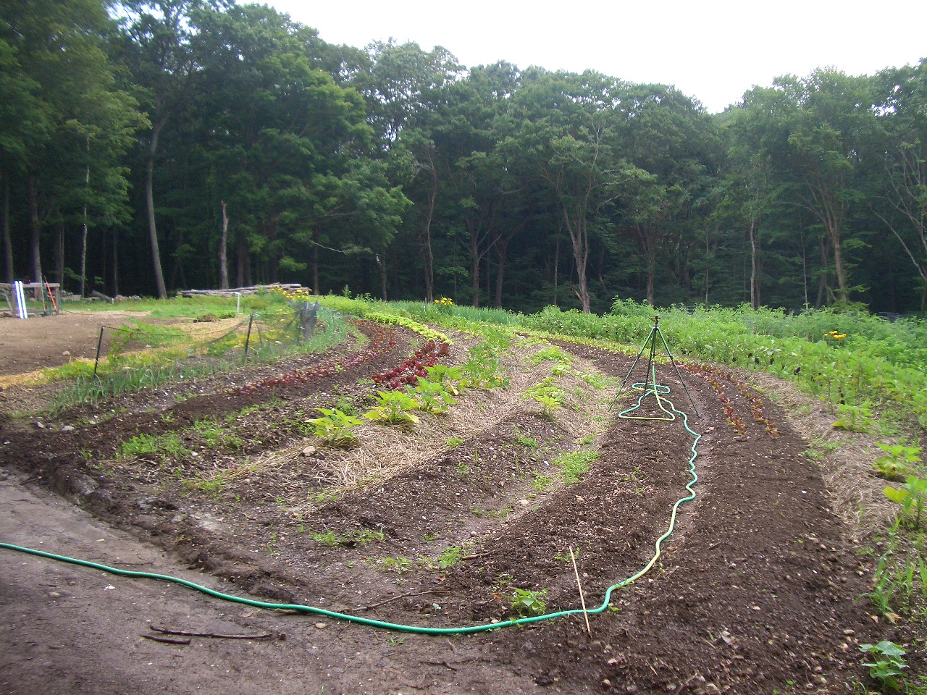
Erosion Control Practice Examples
Contour Farming
Stripcrop and Terraces

Slide 21
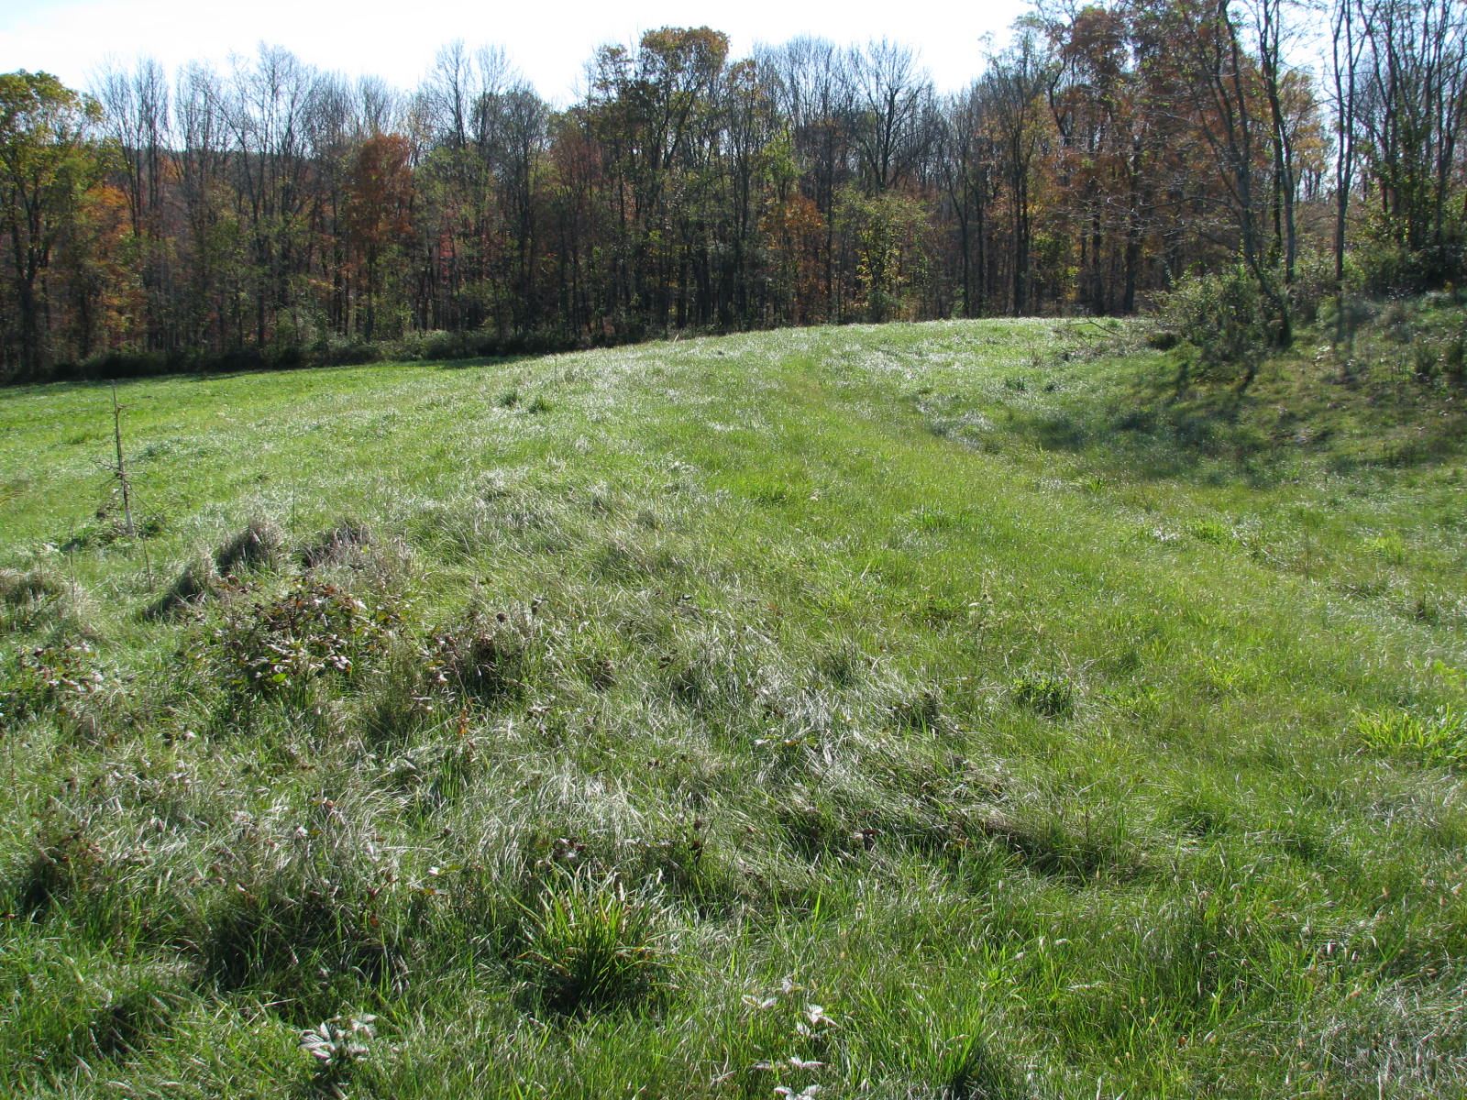
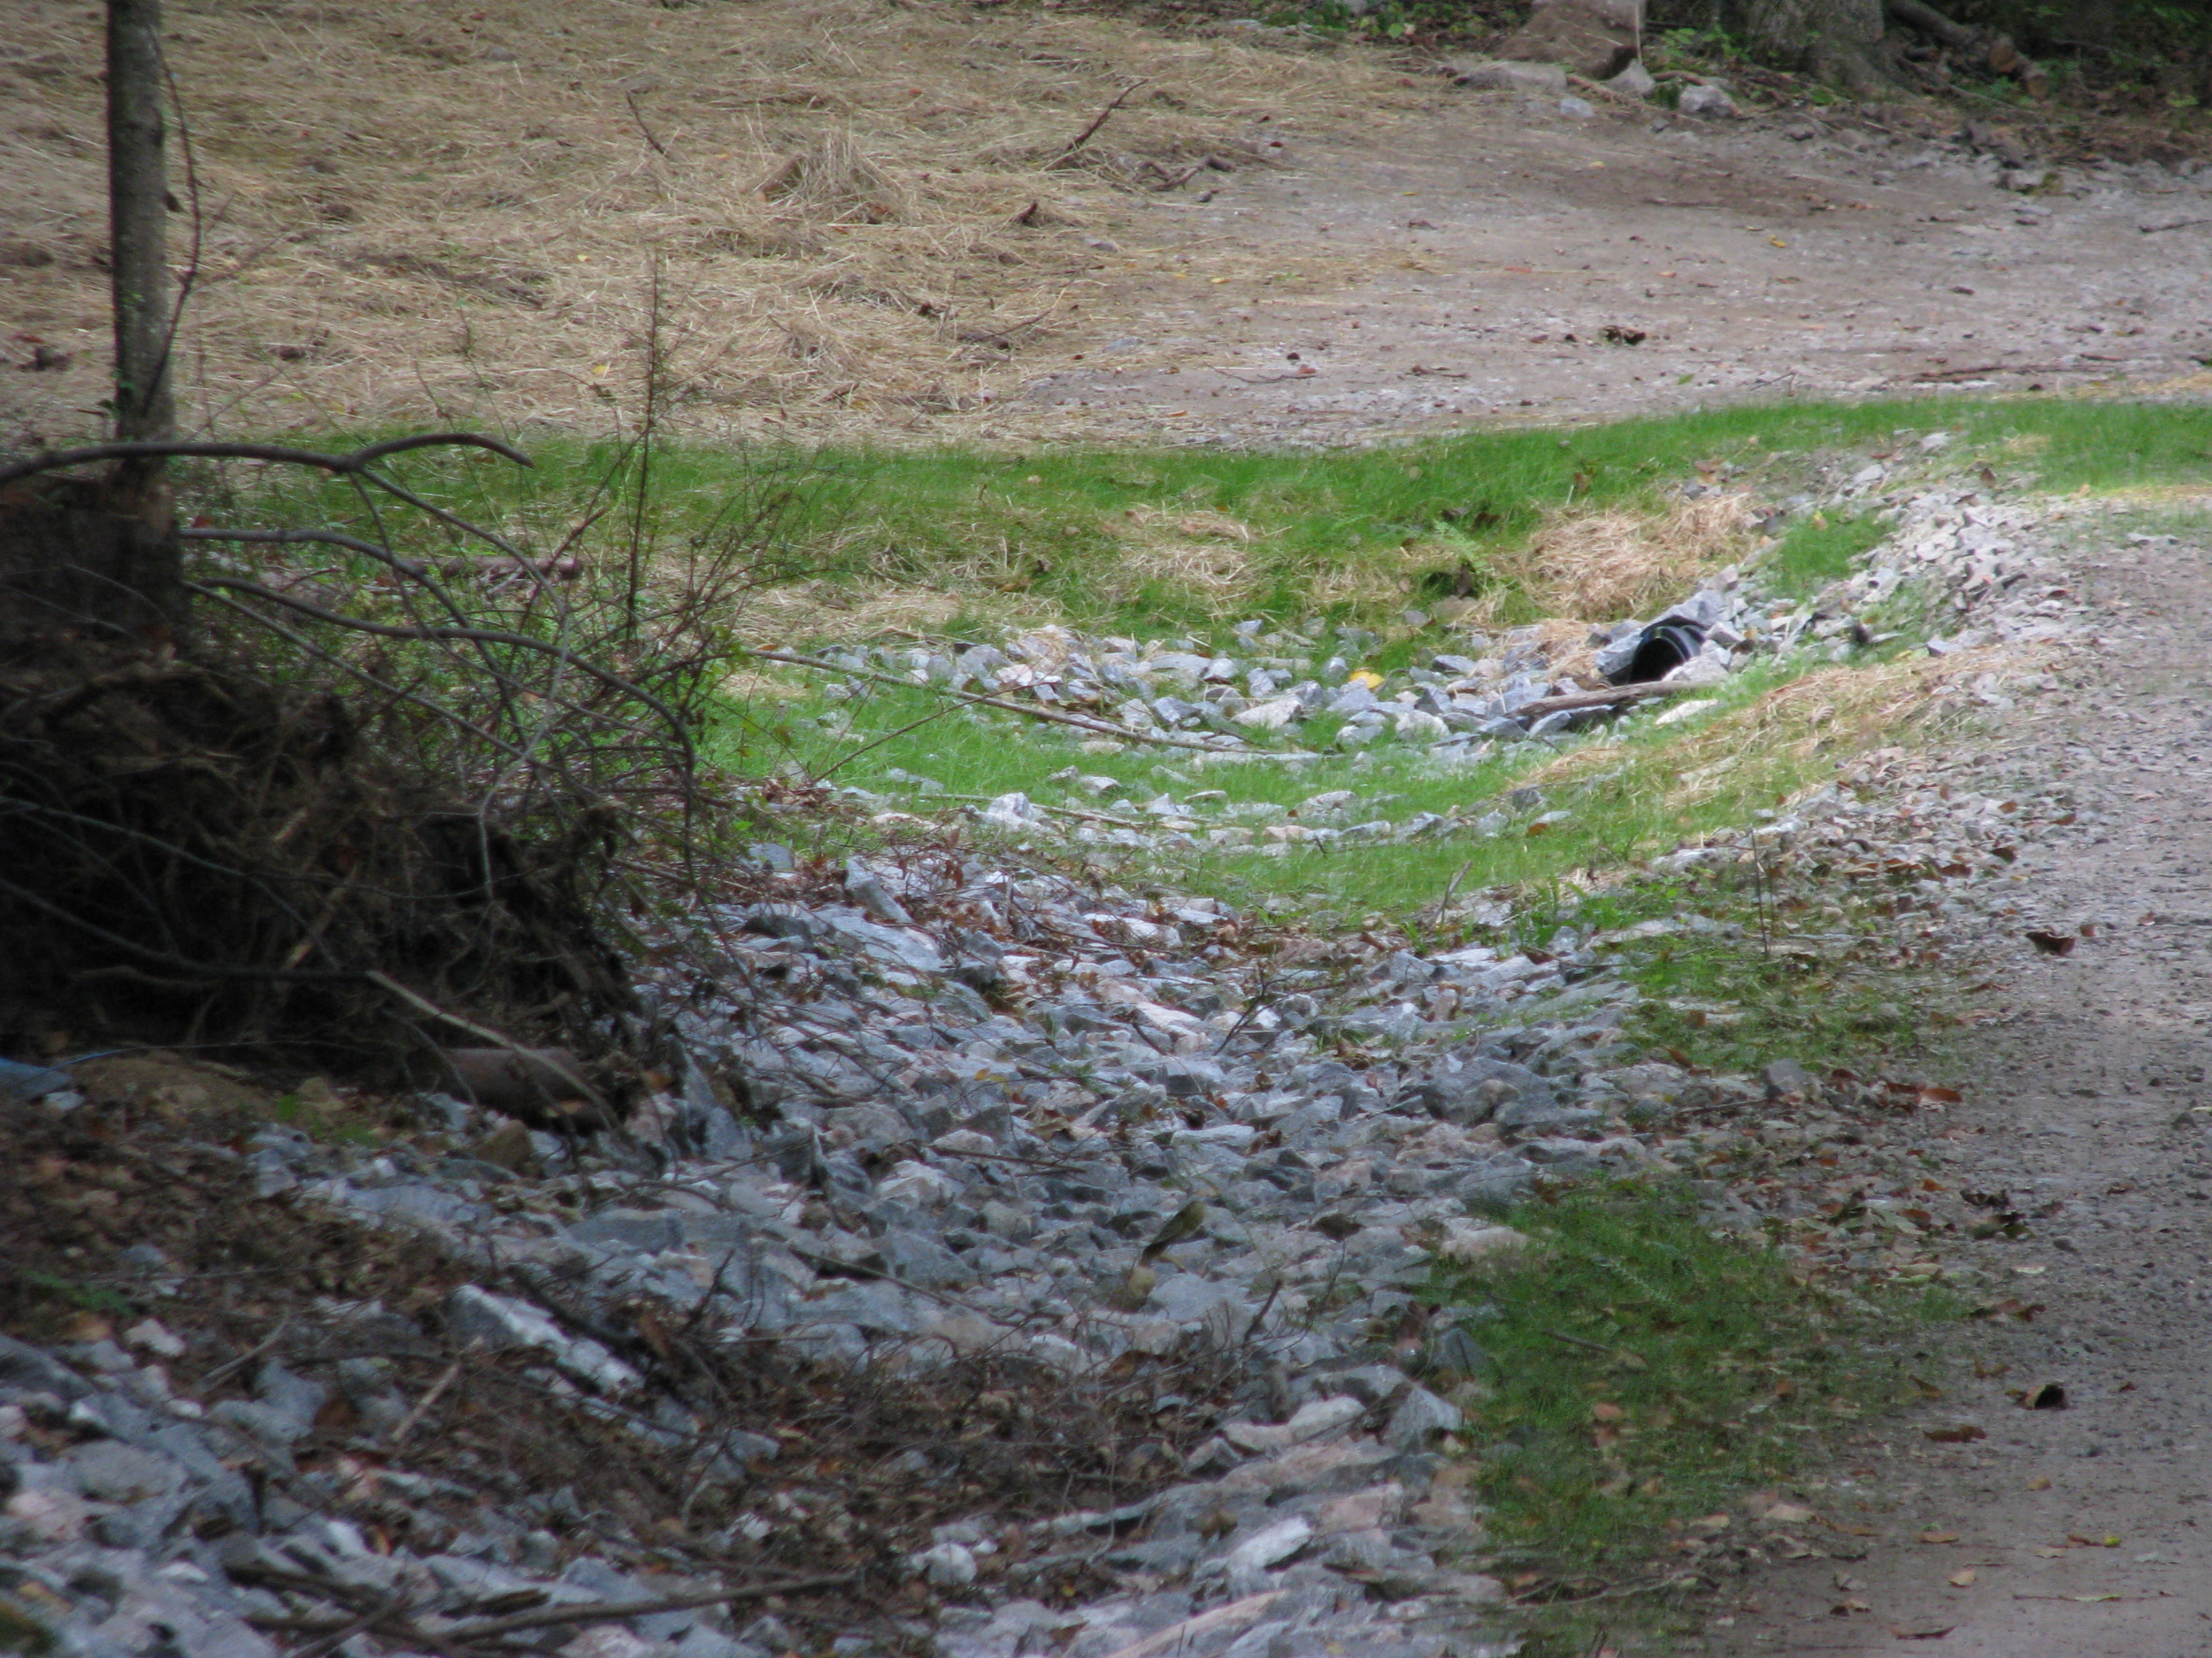
Gully Erosion Control Practice Examples
Diversion
Grassed Waterway
Stone Lined Waterway
Water Control Structure

Slide 22
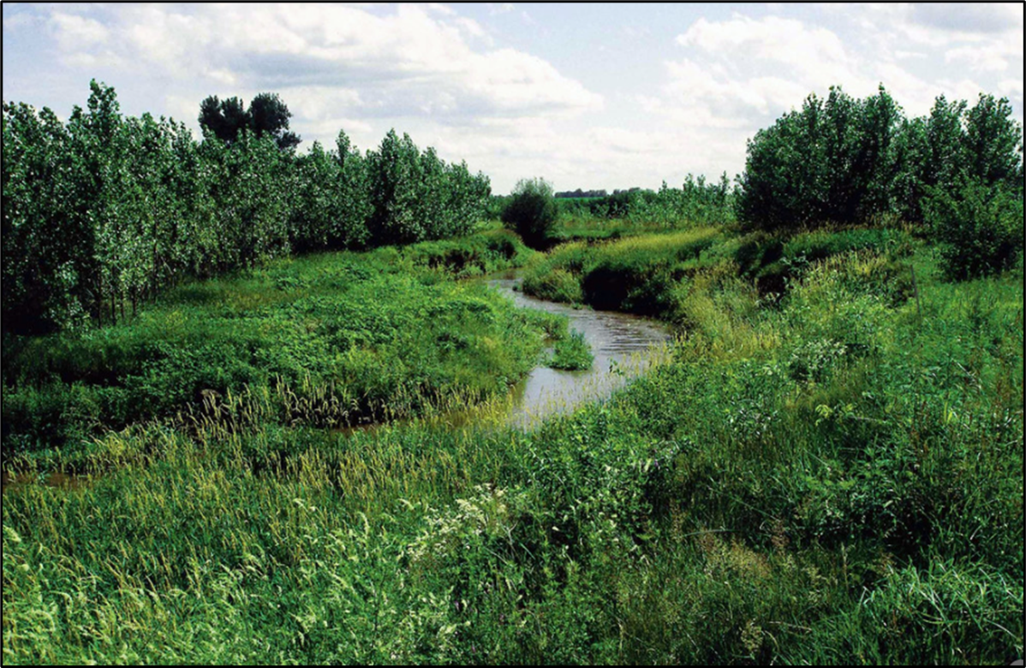
Streambank Erosion Control Practice Examples
Riparian Buffer
Streambank Stabilization

Slide 23
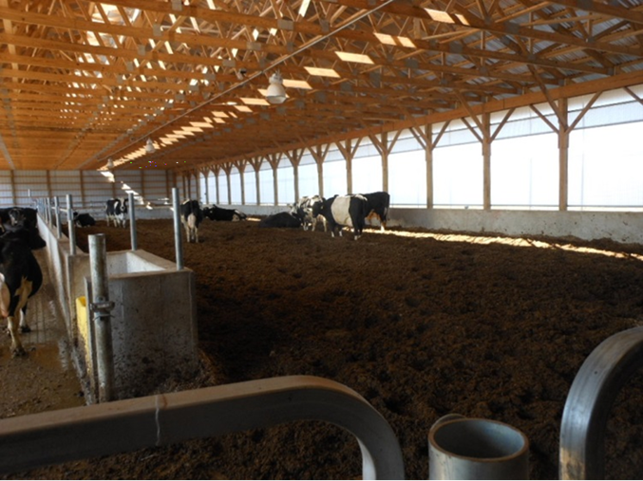
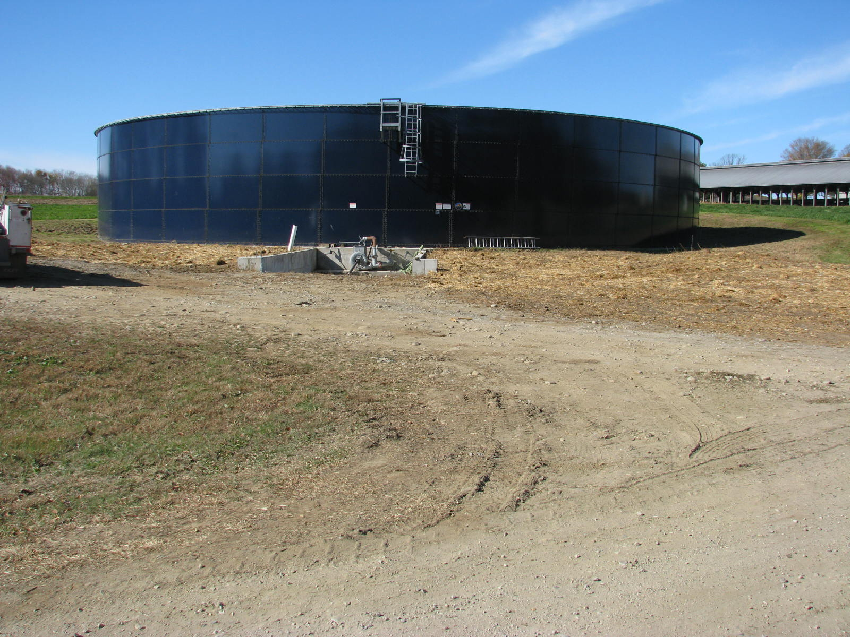
Waste Storage Practice Examples
Waste Storage Facility -Composted Bedded Pack
Waste Storage – tank
Compost Facility
Nutrient Management on Fields

Slide 24
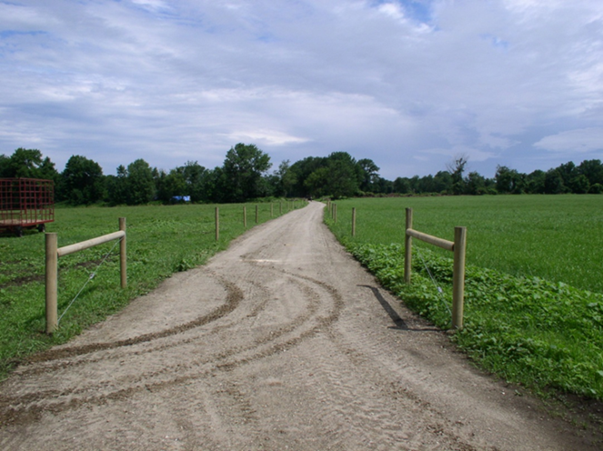
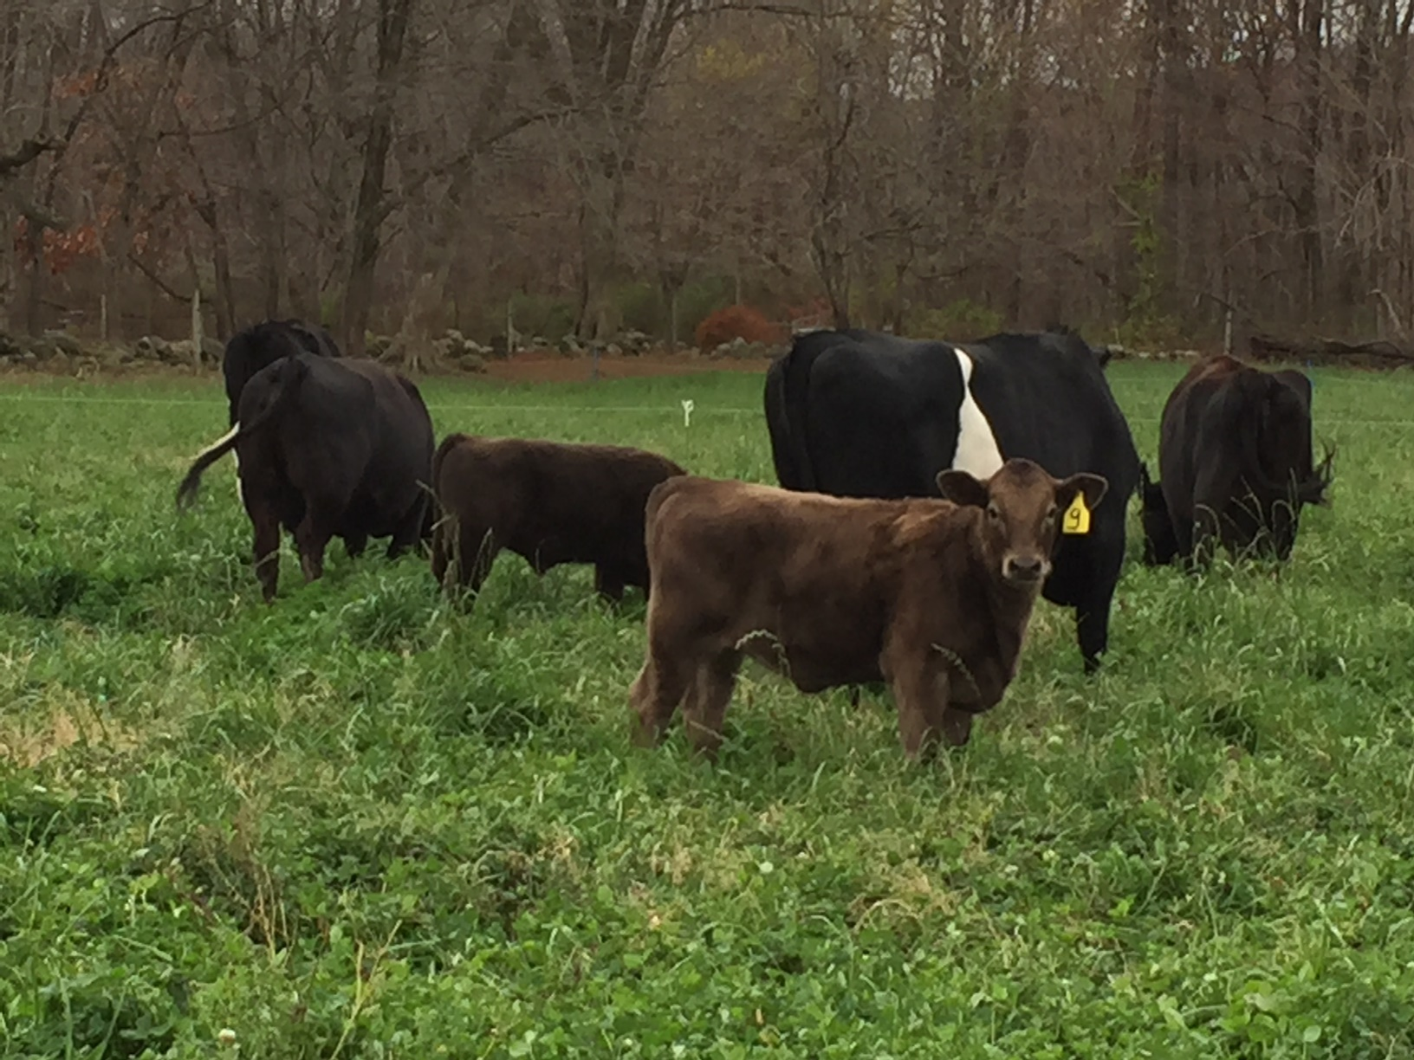
Pasture Practice Examples
Rotational Grazing
Fencing

Slide 25
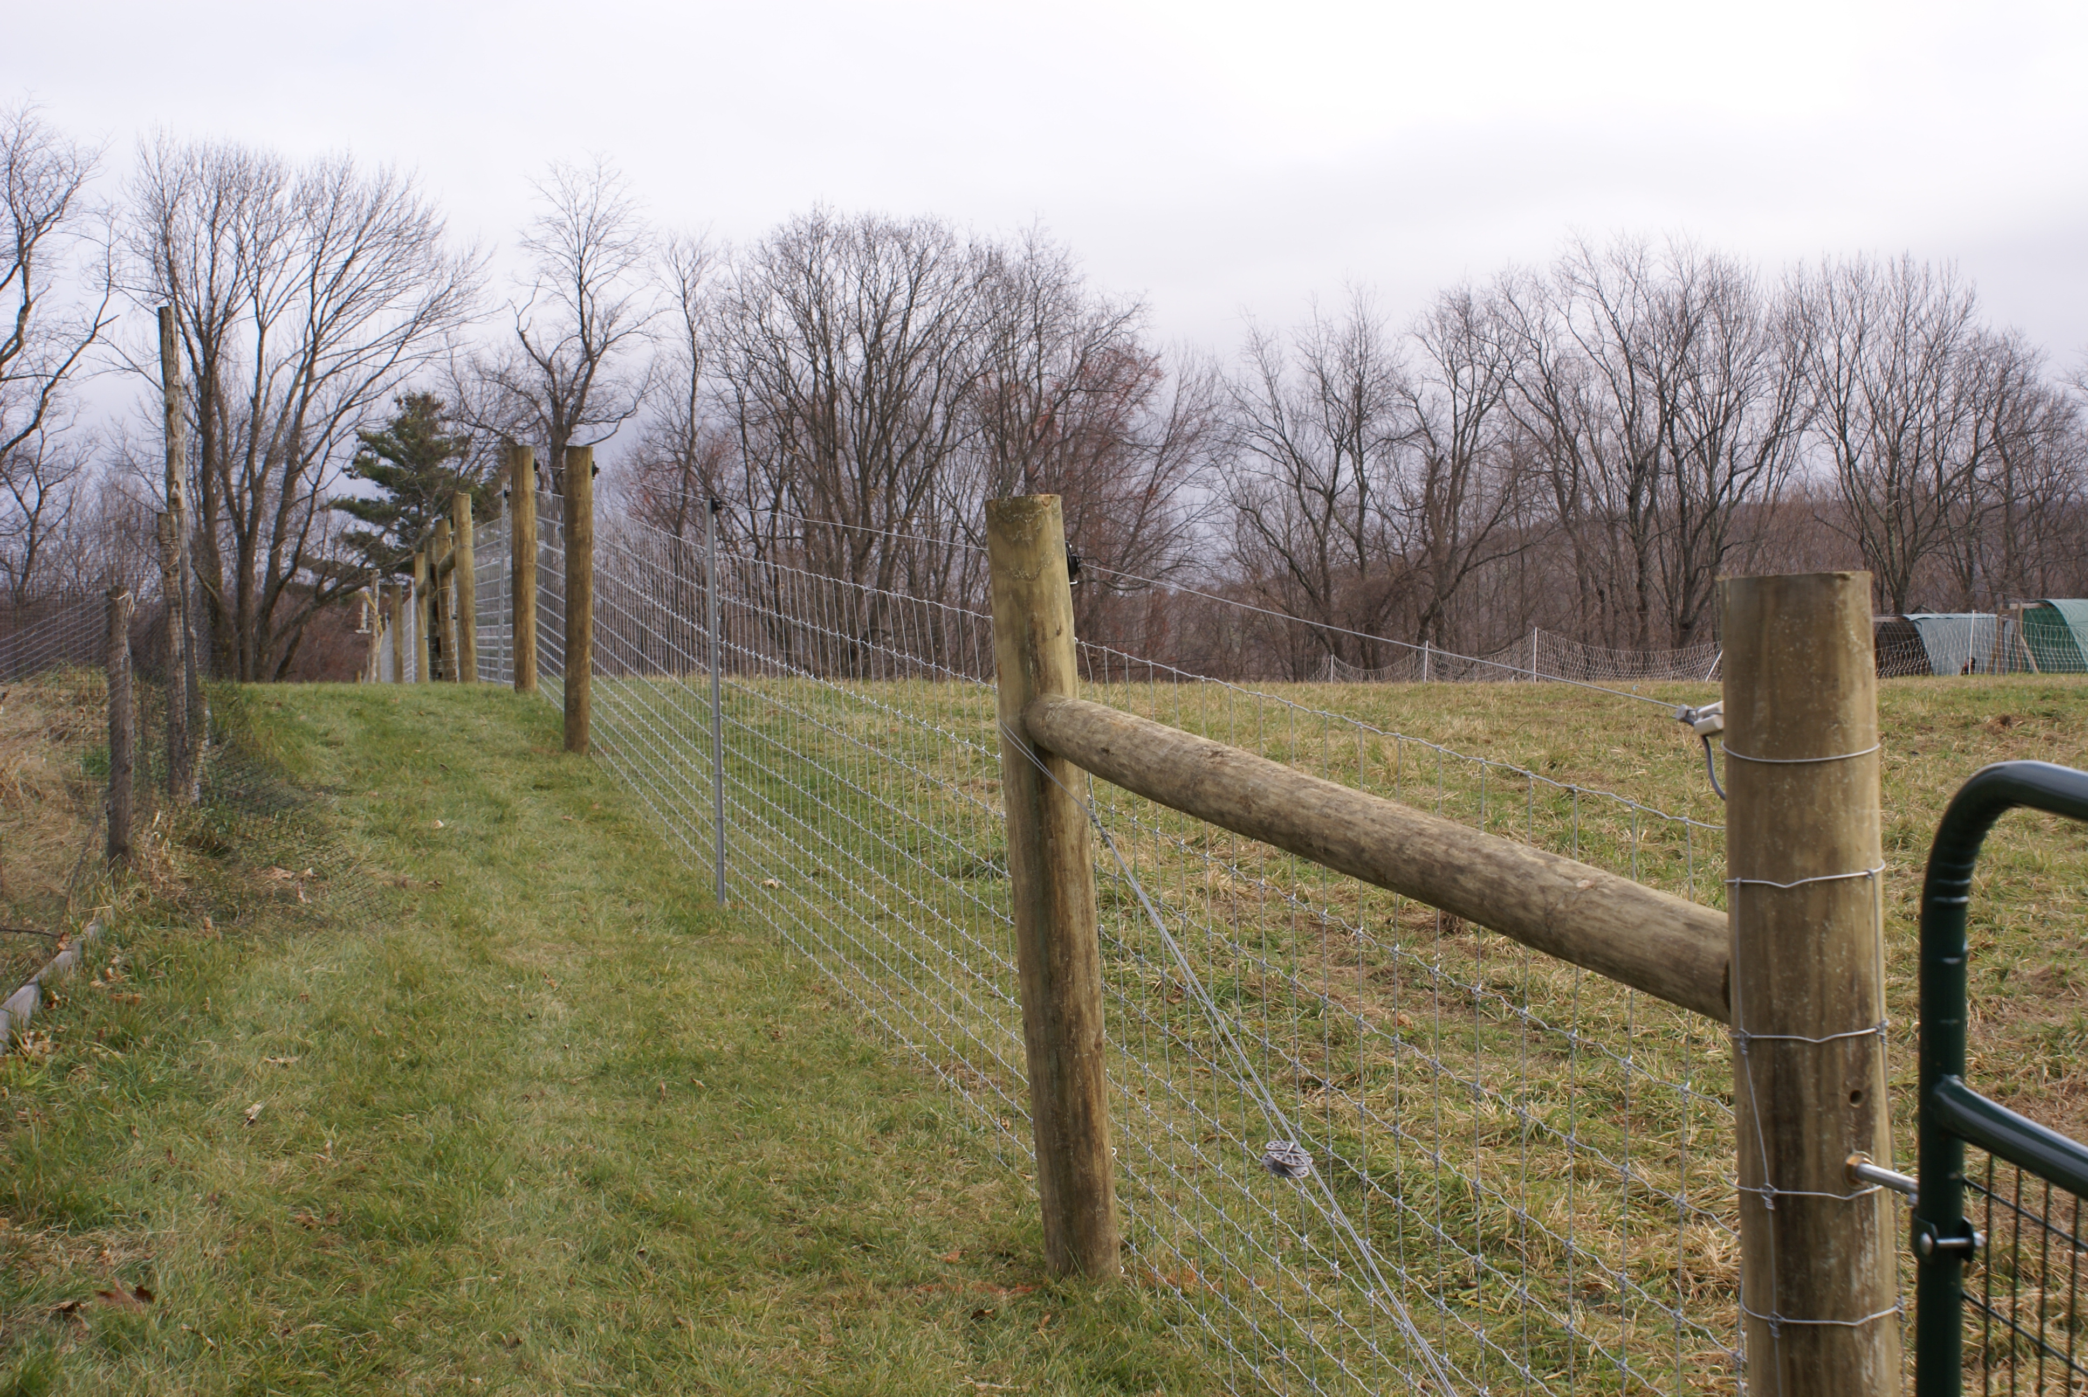
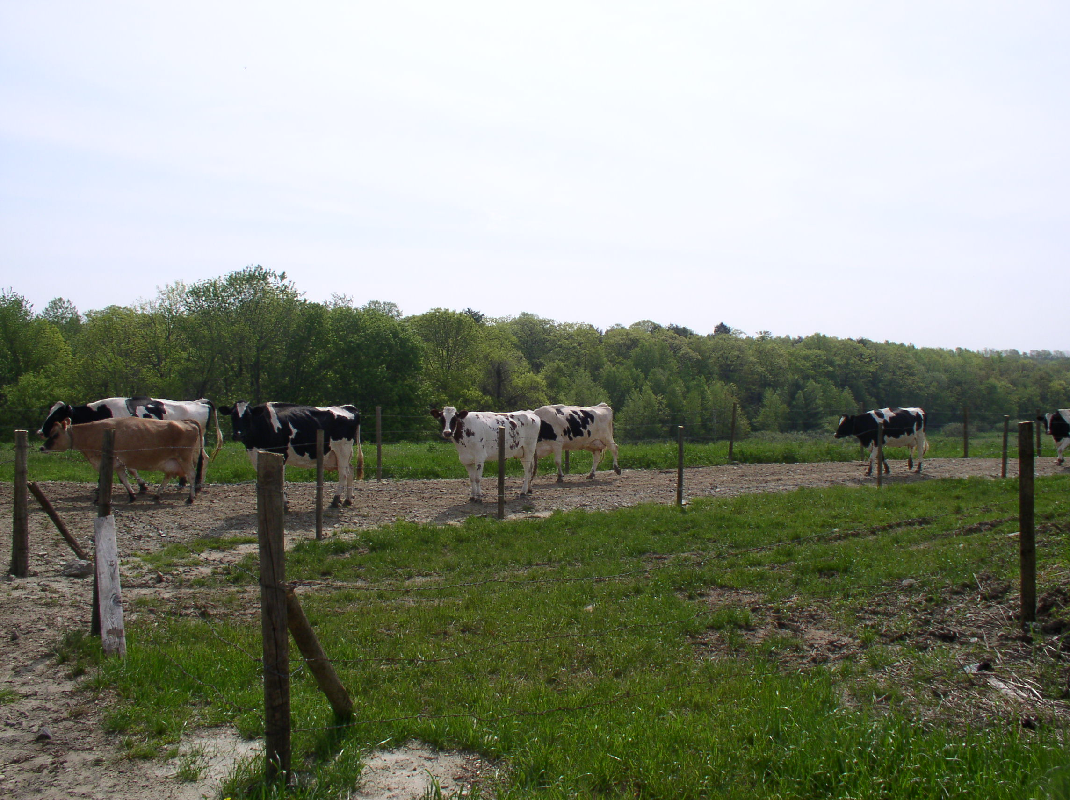
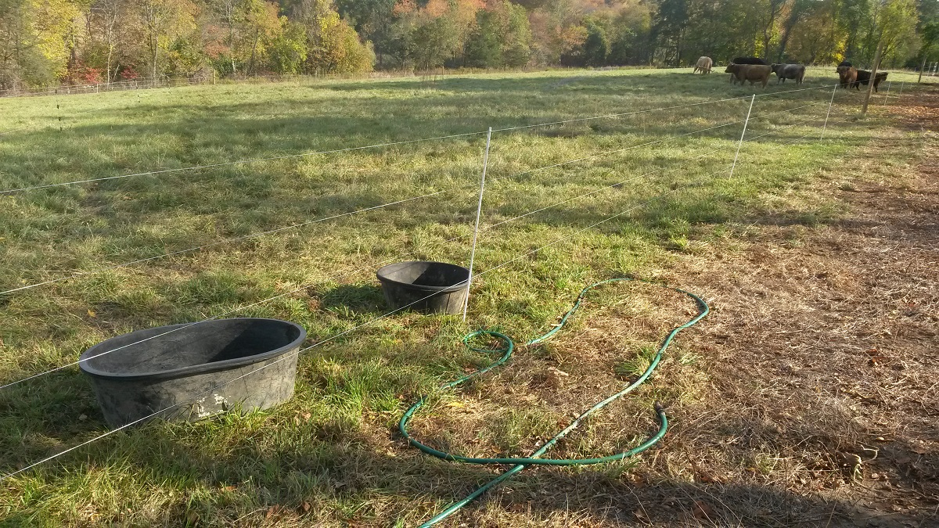
Pasture Practice Examples
Animal Trails
Fencing
Livestock Pipeline
Watering Facility

Slide 26
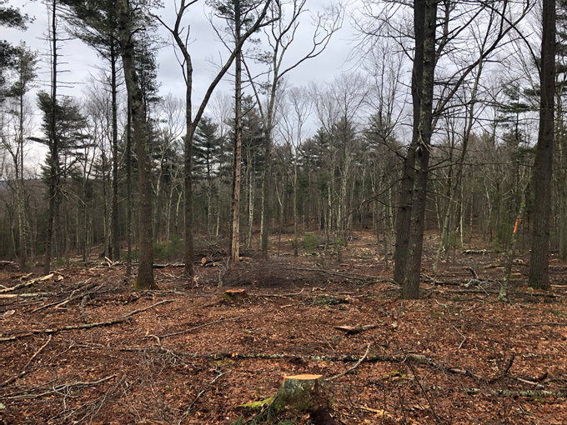
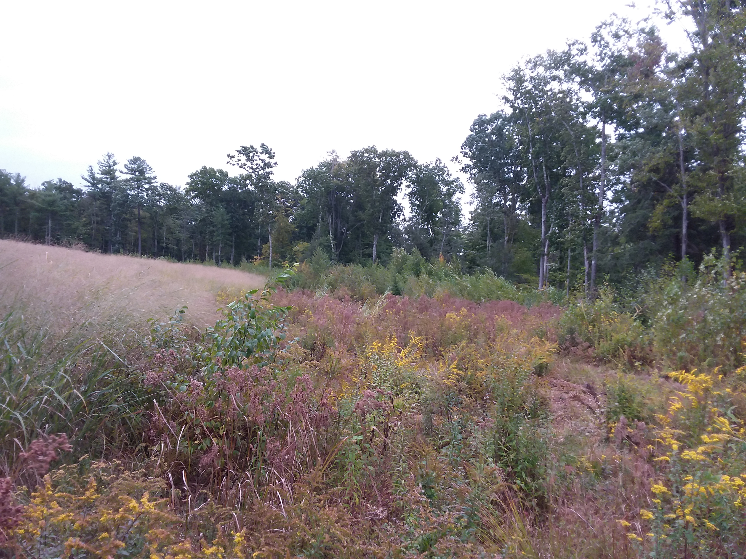
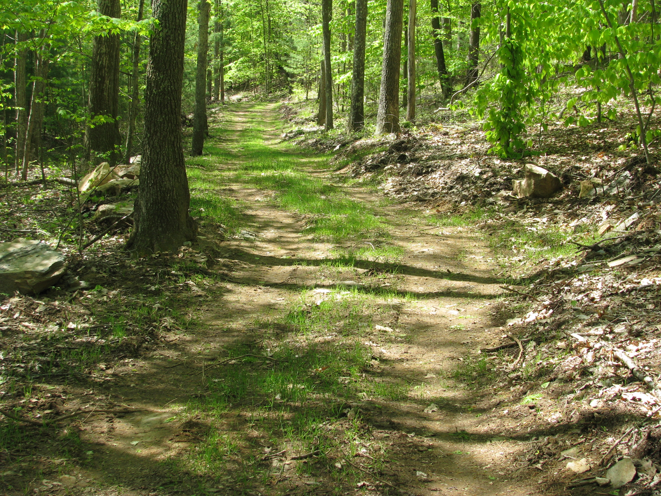
Forestry Practice Examples
Early Successional Habitat Management
Timber Stand Improvement
Forest Trails and Landings
Feather Edging

Slide 27
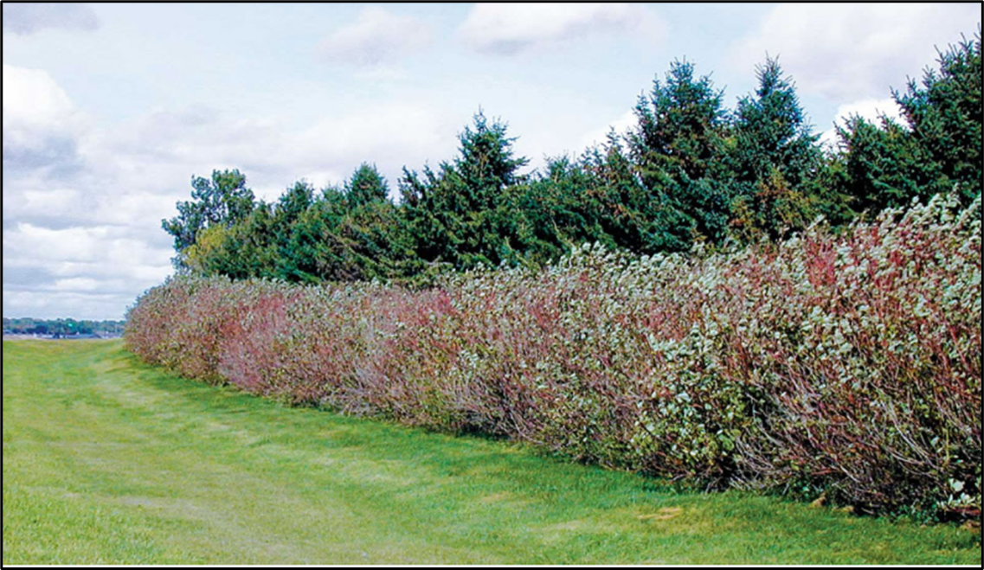
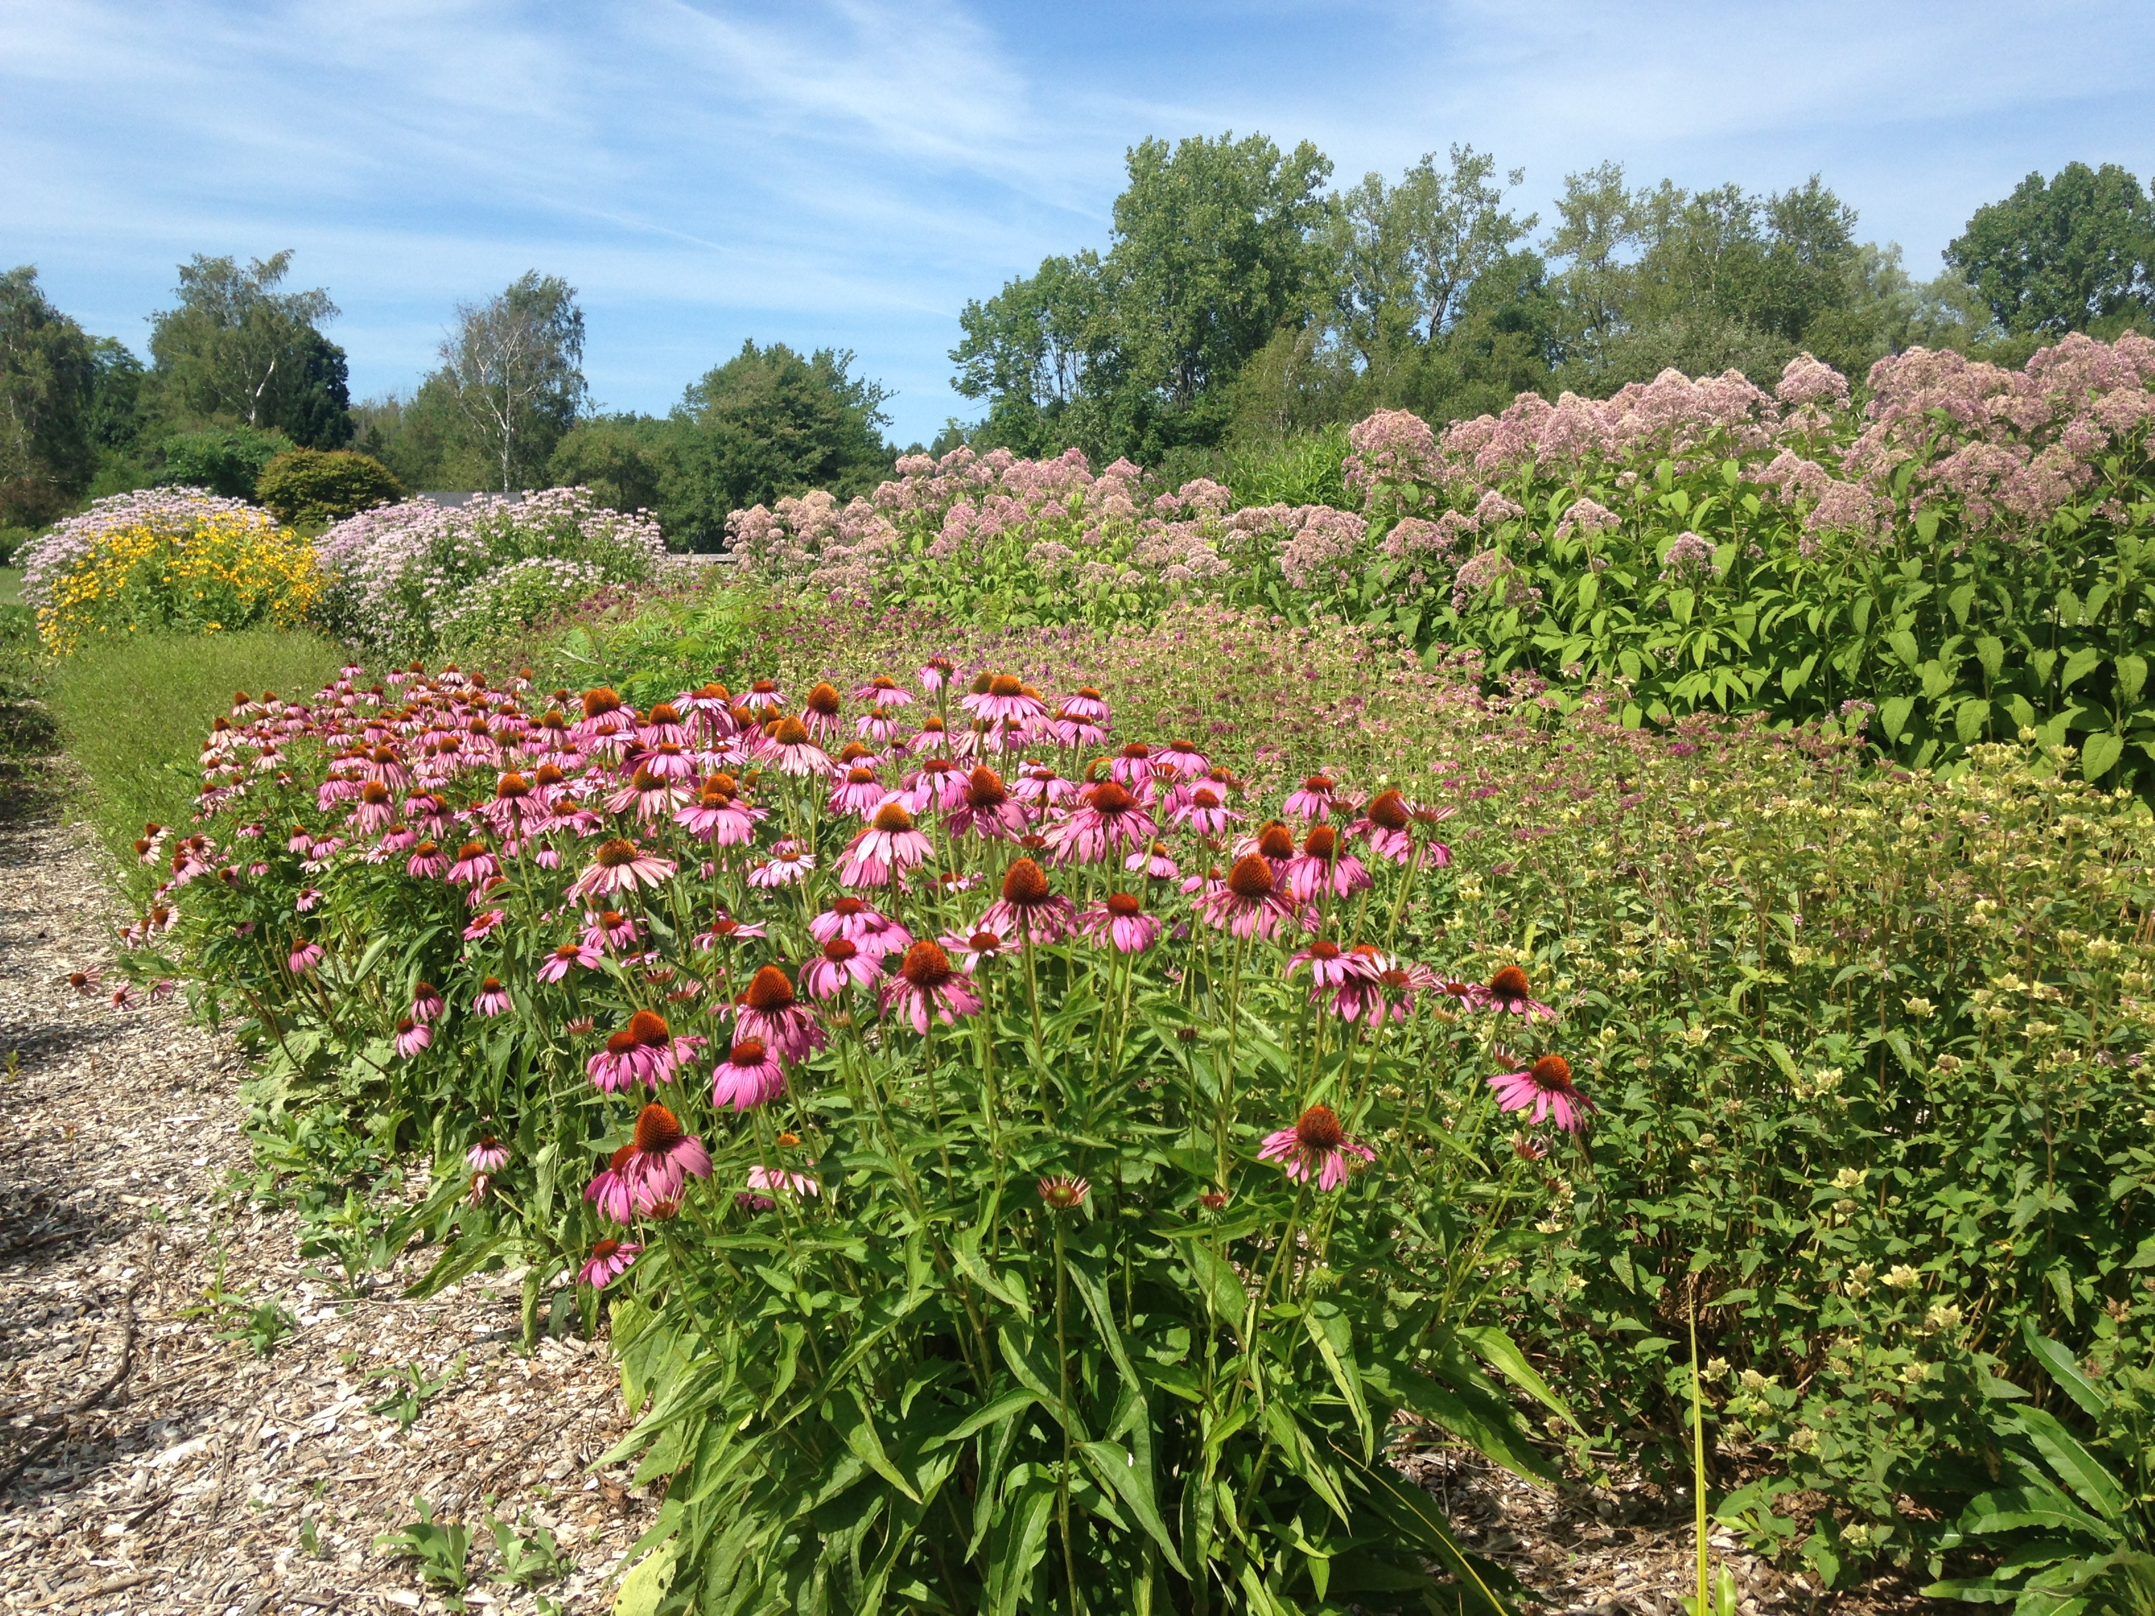
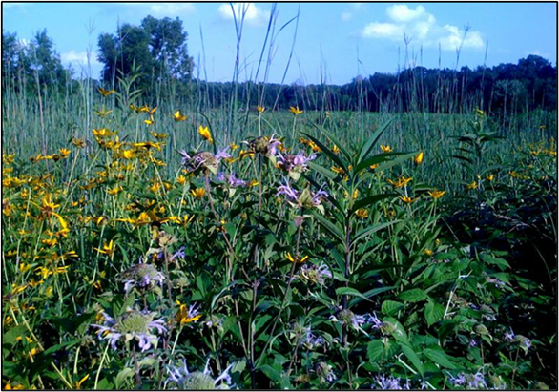
Wildlife Practice Examples
Diversion
Hedgerow
Pollinator Habitat
Field Borders

Slide 28
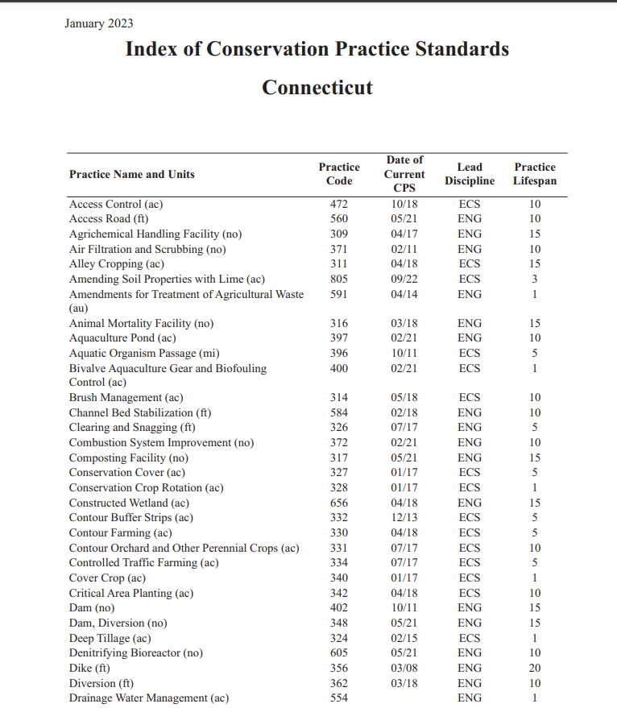
There are over 120 practices available from which to develop a Conservation Plan. Each one is designed to resolve a resource concern either alone or in concert with other practices.

Slide 29
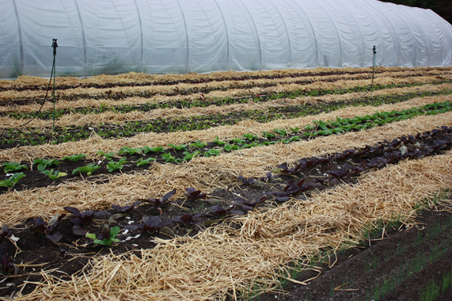
Financial Assistance Programs
Environmental Quality Assistance Program (EQIP)
Agricultural Management Assistance Program (AMA)
Conservation Stewardship program (CSP)
Conservation Innovation Grants (CIG)
Agricultural Conservation Easement Program (ACEP)

Slide 30
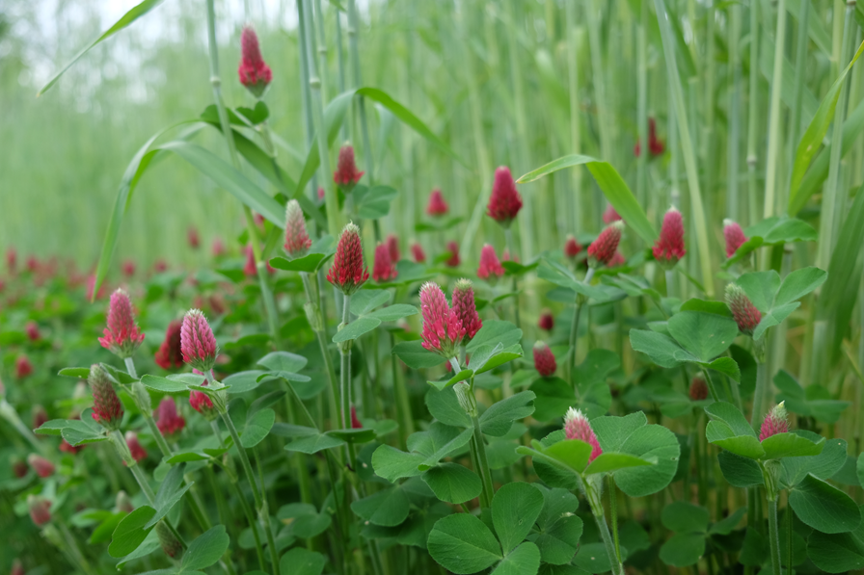
NRCS Program Eligibility
Applicant Eligibility
Land Eligibility
Practice Eligibility
At least one natural resource concern must be identified and addressed with an eligible conservation practice or activity.
Participants must comply with Highly Erodible Land & Wetland Compliance provisions
Participants must be an entity with an interest in agriculture or forestry
Participants must have control of the land involved for the term of the agreement

Slide 31
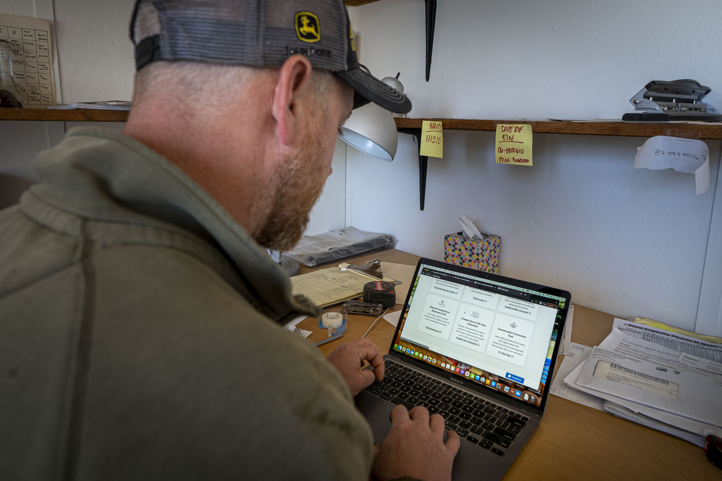
EQIP, AMA, CSP Program Timing
APPLICATIONS ARE BATCHED IN THE FALL & WINTER THEN RANKED *
CONTRACTS ARE OBLIGATED IN THE SPRING & LATE SUMMER *
NRCS ACCEPTS APPLICATIONS YEAR ROUND
*Often a second batch of funding is announced for some programs resulting in late summer contracts
NOW IS A GOOD TIME TO CONTACT FSA AND NRCS TO BEGIN THE PROCESS!

Slide 32
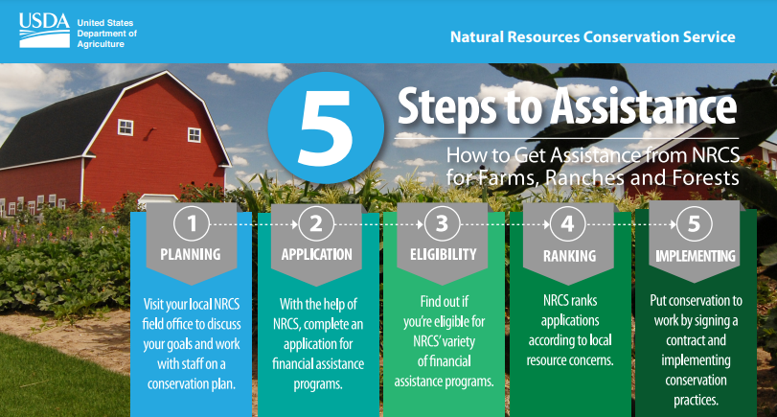
https://www.farmers.gov/
Local Service Center
https://www.farmers.gov/working-with-us/service-center-locator

Slide 33
USDA Nondiscrimination Statement
The U.S. Department of Agriculture (USDA) prohibits discrimination in all its programs and activities on the basis of race, color, national origin, sex, religion, age, disability, political beliefs, sexual orientation, or marital or family status. (Not all prohibited bases apply to all programs.) Persons with disabilities who require alternative means for communication of program information (Braille, large print, audiotape, etc.) should contact USDA's TARGET Center at (202) 720-2600 (voice and TDD).
To file a complaint of discrimination, write USDA, Director, Office of Civil Rights, Room 326-W, Whitten Building, 1400 Independence Avenue, SW, Washington, D.C. 20250-9410 or call (202) 720-5964 (voice and TDD). USDA is an equal opportunity provider and employer.

Slide 34
CT NRCS CONTACTS:
STATEWIDE
Vivian Felten, Outreach Coordinator
(860) 237-7719
vivian.felten@usda.gov
LITCHFIELD COUNTY
Torrington Service Center
(860) 626-8852
Lilliam Torres, Acting
District Conservationist
lilliam.torres@usda.gov
HARTFORD & TOLLAND COUNTIES
Windsor Service Center
(860) 688-7725
Adam Maikshilo
District Conservationist adam.maikshilo@usda.gov
NEW LONDON & MIDDLESEX COUNTIES
Norwich Service Center
(860) 319-8803
Garrett Timmons
District Conservationist garrett.timmons@usda.gov
NEW HAVEN & FARIFIELD COUNTIES
Hamden Service Center
(203) 259-7002
Diane Blais
District Conservationist
diane.blais@usda.gov
WINDHAM COUNTY
Danielson Service Center
(860) 412-5260
Bill Purcell
District Conservationist
william.purcell@usda.gov

